Slide 1
COM506 Term Project
Creating Freight Indexes Information
Hyuncheol Ryu
August 2022

Slide 2
Contents
Section
1 [Introduction] 2
A [Statement of Problem] 2
B [Plan] 4
2 [Methods] 6
A [Research] 6
3 [Results] 13
A [Deliverables] 13
4 [Discussion] 15
A [Implication] 15

Slide 3
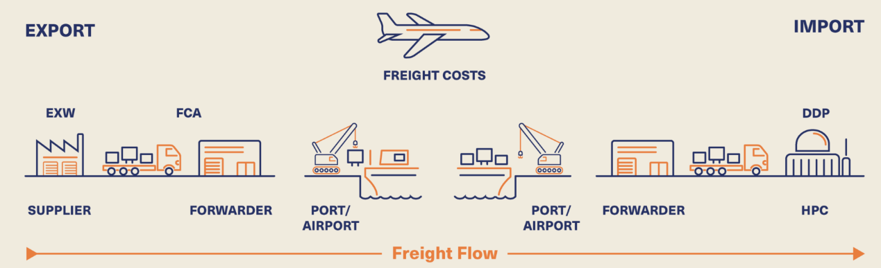
1. Introduction 》Statement of Problem (1/2)
Section 1
Forwarding and Pricing
- Forwarding is a business that arranges the logistics of import and export cargo. Pricing, one of the forwarding tasks, plays the role of a negotiator by purchasing supplies from airlines and shipping companies at low prices and charging customers for logistics costs at high prices.
Freight Flow
Export
Import
Freight Costs
Supplier
Forwarding
Company
PORT /
AIRPORT
PORT /
AIRPORT
Forwarding
Company
Consumer
(https://osprey.group/our-expertise/project-freight-forwarding/)
Forwarding refers to the business of arranging the logistics of import/export cargo by using the logistics facilities and equipment of the supplier in the name of the forwarding company at the request of the consumer. The consumer will want to charge the forwarding company for freight costs at the lowest possible price, and the supplier will want to collect the logistics and transportation costs at the highest possible price.
At this point, the need for the forwarding company's pricing task arises. That is, the person in charge of pricing is responsible for establishing and implementing strategies for air and ocean international freight rates, contacting airlines and shipping companies to identify trends, and securing supply space through seasonal cargo capacity management.

Slide 4
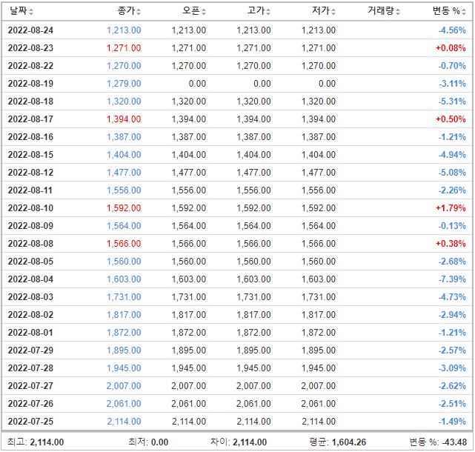
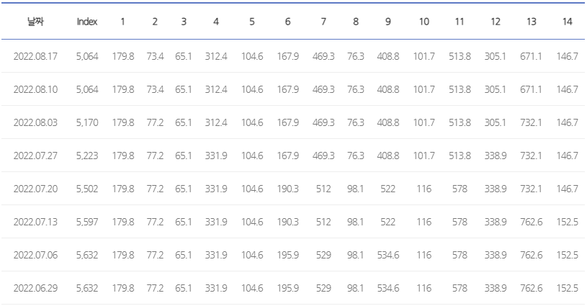
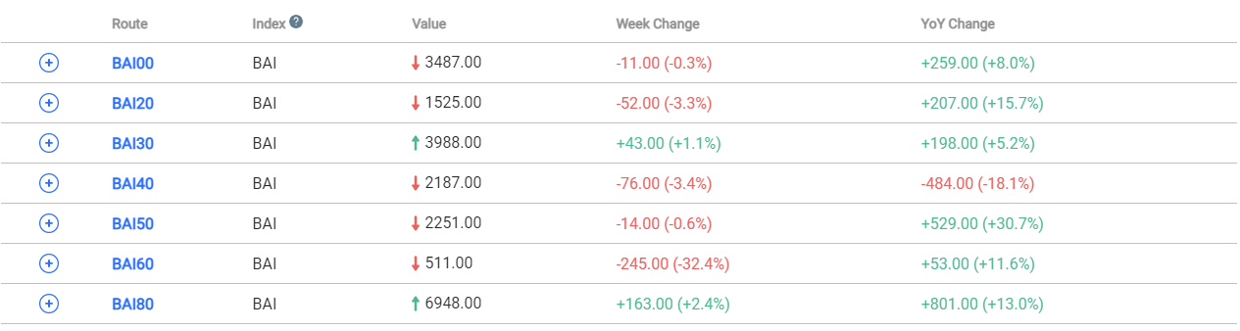
1. Introduction 》Statement of Problem (2/2)
Section 1
Issues in Pricing tasks
- Due to the nature of the pricing tasks, it is necessary to check the freight indexes daily. However, as the management subject for each freight index is different, work inefficiency occurs in the pricing process. To improve this, it is necessary to make it possible to view and manage the entire index in one channel.
Freight Indexes List
Key Findings
BDI (Baltic Dry Index)
HRCI (Howe Robinson Container Index)
Inefficiency in the pricing process
(https://www.ksg.co.kr/shippingGraph/hrci_graph.jsp)
Time wasted in the process of visiting each index web page and checking the index
Data input processing and accumulation management for daily index data is done manually
(https://kr.investing.com/indices/baltic-dry-historical-data)
BAI (Baltic Air Freight Indices)
(https://dashboard.tacindex.com/dashboard)
CCFI (China Containerized Freight Index)
(https://www.kcla.kr/web/inc/html/4-1_2.asp)
Need Improvement
SCFI (Shanghai Containerized Freight Index)
It should be possible to check all indexes in one channel
Daily freight indexes value must be stored in a database
(https://www.tradlinx.com/freight-index)
There are a total of 5 freight indexes that should be referenced in the pricing tasks
Each index has a different management entity, so the person in charge must visit a different web page to check the index data

Slide 5





1. Introduction 》Plan (1/2)
Section 1
Implementation Plan
- The team established an implementation plan for the Collecting-Processing-Storing-Querying procedure so that freight indexes can be viewed and managed in one channel.
Problem Solving Process
Data Source (Freight Indexes)
Collecting & Processing
Storing
Querying
web page A (BDI)
web page B (CCFI)
Data Scraping
Saving as a CSV file
Creating a Database file
Importing a CSV file into DB
Running a query
web page C (SCFI)
< Standardized Form >
Date
Index
Value
···
web page D (HRCI)
web page E (BAI)
2022-08-15
BDI
1,279.00
···
2022-08-15
CCFI
2,993.67
···
···
Scrapping freight indexes for each web page using BeautifulSoup, Selenium packages
Transforming table of indexes data into a standardized form
Saving it as a CSV files
Connecting to the SQLite DB file and importing the CSV files through Python
Assigning a primary key and a foreign key to each table
Writing and executing query statements such as Create, Read, Update, and Delete
Defining the data source that we want to scrap
Designing the ERD of the database

Slide 6
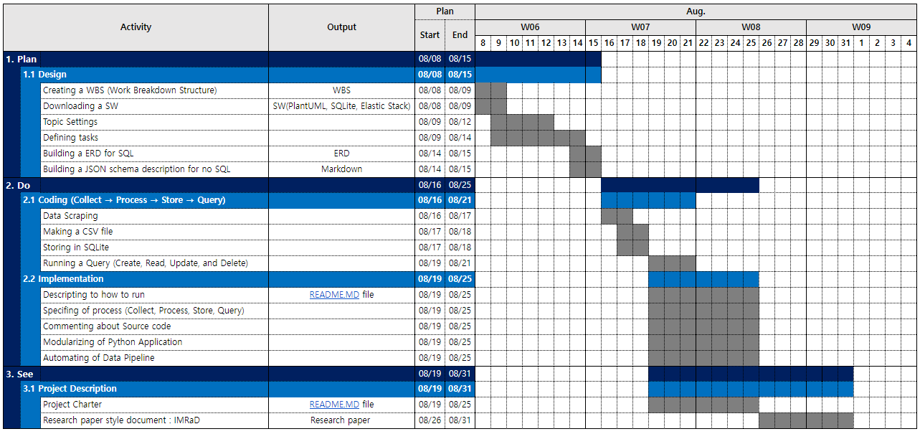
1. Introduction 》Plan (2/2)
Section 1
Project Schedule
- The project was carried out over a total of 24 days from 8/8 to 8/31.
Schedule Chart

Slide 7
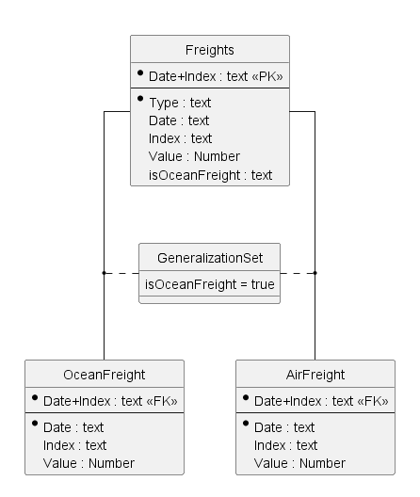
2. Methods 》Research (1/7)
Section 2
Entity Relationship Diagram (ERD)
- The team designed the ERD which is a database design for the supertype/subtype relationship using PlantUML.
Description of ERD
Relationship Between Supertype & Subtype Entities
Description
Supertype Entity : Freights
Attributes
Type
One of 'OceanFreight' and 'AirFreight'
Date
The date the value was recorded
Index
One of 'BDI' & 'CCFI' & 'SCFI' & 'HRCI' & 'BAI'
Value
Index Value
IsOceanFreight
'True' if Type is OceanFreight
Date+Index (PK)
A Combination of Date and Index, Which is the PK of this table
1
1
2
GeneralizationSet
If the value in the IsOceanFreight is true, the OceanFreight table; otherwise, the AirFreight table
2
3
Supertype Entities : OceanFrieght, AirFreight
Other than the Date+Index designated as FK, the remaining columns are the same as the Freights entity
3

Slide 8
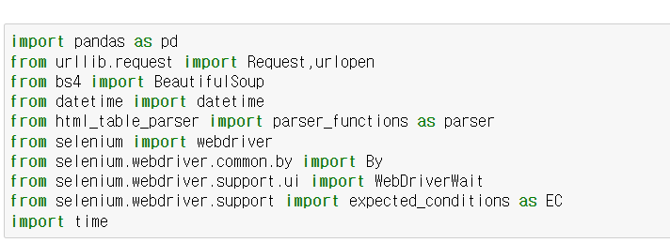
2. Methods 》Research (2/7)
Section 2
Collecting & Processing
- A total of 7 packages were used to scrape and process index data.
Collecting
Processing
Storing
Querying
Description of 'Collecting & Processing' Process
Code
Description
1
Importing the necessary packages
Packages
Pandas
It is used to convert index data scraped by web pages into a data frame.
Request, urlopen
It is a package required to access URLs with index information.
BeautifulSoup
It is a Python package for parsing HTML and XML documents.
Datetime
It is a package to put a time value in columns that do not have a Date value.
Html_table_parser
It is a package that parses table in HTML.
Selenium
It is a package needed to scrape data created dynamically by javascript.
Time
It is a package required to wait for the loading of dynamic web pages.
1

Slide 9
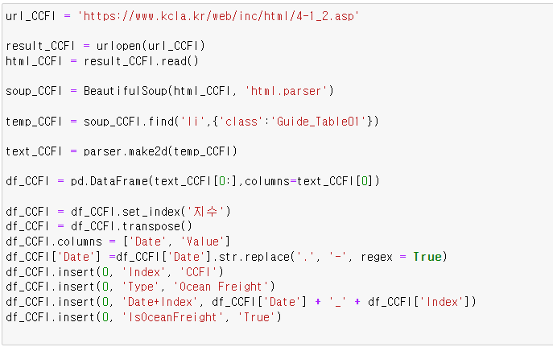
2. Methods 》Research (3/7)
Section 2
Collecting & Processing
- The team scraped the index data from the web page for each index, changed it into a data frame, and matched it to a standardized format.
Collecting
Processing
Storing
Querying
Description of 'Collecting & Processing' Process
Code
Description
1
Setting the URL information where the index data is displayed.
Getting information about webpage using Python's built-in module, 'urllib'.
Parsing HTML using 'html.parser'
Getting the value of the tag information of the desired location
Storing the imported value in the text_(index) variable, using 'make2d'
Converting the saved data into data frame format
Converting the data frame format to a standardized format
1
2
2
3
3
4
4
5
6
5
7
6
7

Slide 10
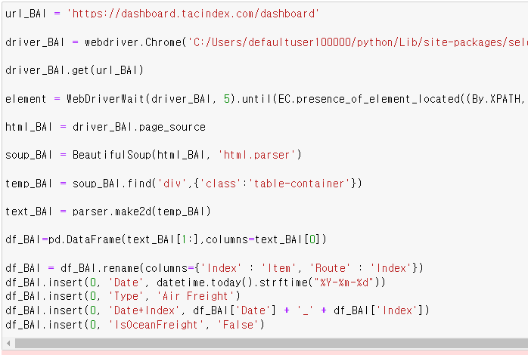
2. Methods 》Research (4/7)
Section 2
Collecting & Processing
- In the case of BAI, BDI, and SCFI, since there is an index value on the dynamic homepage, the Selenium package was additionally used to scrap the data.
Collecting
Processing
Storing
Querying
Description of 'Collecting & Processing' Process
Code
Description
1
Setting the URL information where the index data is displayed.
Specifying the location of the chrome driver, After creating an object with the url_(index) variable.
Accessing the URL
Waiting up to 5 seconds for web support to load, In the case of 'explicitly wait', it is a command to wait until the part I need is displayed.
Getting information about the webpage.
Parsing html using 'html.parser'
Getting the value of the tag information of the desired location
Storing the imported value in the text_(index) variable, using 'make2d'
Converting the saved data into a data frame format
Converting the data frame format to a standardized format
1
2
3
Selenium package
2
4
3
5
4
6
7
5
8
6
9
7
10
8
9
10

Slide 11
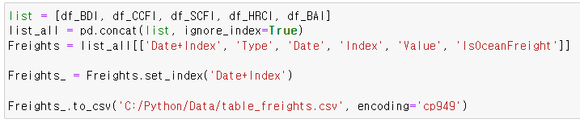
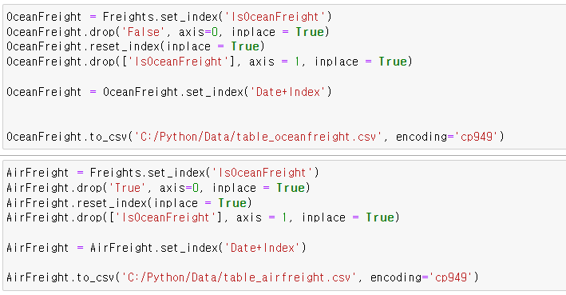
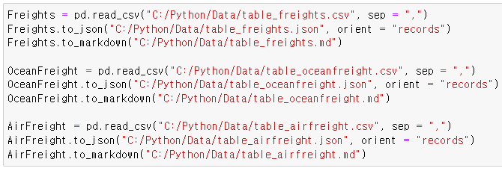
2. Methods 》Research (5/7)
Section 2
Collecting & Processing
- The team merged each index data into one and saved it as a CSV / JSON file.
Collecting
Processing
Storing
Querying
Description of 'Collecting & Processing' Process
Code
Description
Merging data frames for each index into one (All Freight indexes)
When saving as CSV, Setting the index information so that the index column is not saved.
Saving the data frame as a CSV file
Proceeding in the same way for the Oceanfreight table and Airfreight table.
Saving the data frame as a JSON file
1
1
2
2
3
3
4
4
5
5

Slide 12
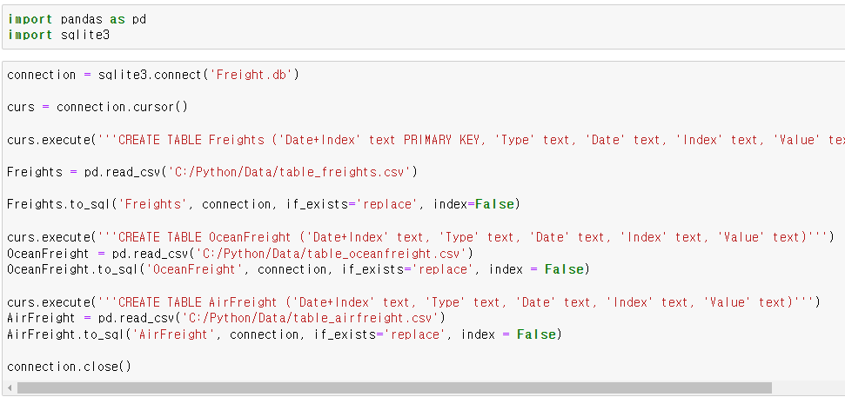
2. Methods 》Research (6/7)
Section 2
Storing
- The team created a table in Python by creating a database of SQLite and then importing the CSV file stored in the previous step.
Collecting
Processing
Storing
Querying
Description of 'Storing' Process
Code
Description
Importing the necessary packages
Packages
Pandas
It is a package required to load CSV files into a Panda's data frame.
Sqlite3
It is a package that allows to utilize the functions of SQLite in Python.
Connecting/creating to database
Creating a cursor object
Executing a query that creates a 'Freights' table
Loading CSV data into a pandas data frame
Writing the data to a SQLite DB table
Loading another CSV file into the databases (Oceanfreight, Airfreight indexes)
Closing connection to SQLite database
1
1
2
3
4
5
6
7
2
3
4
5
8
6
7
8

Slide 13
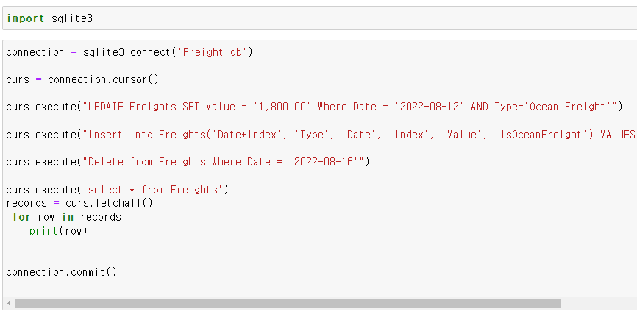
2. Methods 》Research (7/7)
Section 2
Querying
- The team ran queries such as Create, Select, Update, Delete, and Insert in Python.
Collecting
Processing
Storing
Querying
Description of 'Querying' Process
Code
Description
Importing the necessary packages
Package
Sqlite3
It is a package that allows to utilize the functions of SQLite in Python.
Connecting/creating to database
Creating a cursor object
Running Update query
Running Insert query
Running Delete query
Running Select query
Closing connection to SQLite database
※ In the case of Create query, the table was created in the 'Storing' step
1
1
2
3
4
5
2
6
3
7
4
5
6
7
8
8

Slide 14
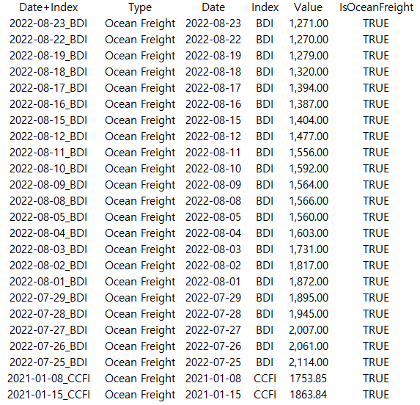
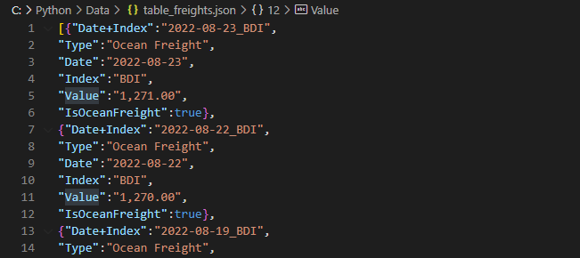
3. Results 》Deliverables (1/2)
Section 3
Collecting & Processing
- The team converted the index data from different formats on each web page into a standardized format CSV/JSON file.
Deliverables of Project
Raw data (Freight indexes)
CSV / JSON file
BDI (Baltic Dry Index)
HRCI (Howe Robinson Container Index)
(https://kr.investing.com/indices/baltic-dry-historical-data)
(https://www.ksg.co.kr/shippingGraph/hrci_graph.jsp)
BAI (Baltic Air Freight Indices)
·
·
·
(https://dashboard.tacindex.com/dashboard)
CCFI (China Containerized Freight Index)
(https://www.kcla.kr/web/inc/html/4-1_2.asp)
SCFI (Shanghai Containerized Freight Index)
·
·
·
CSV / JSON file for a total of 5 index information including BDI, HRCI, CCFI, SCFI, and BAI
(https://www.tradlinx.com/freight-index)

Slide 15
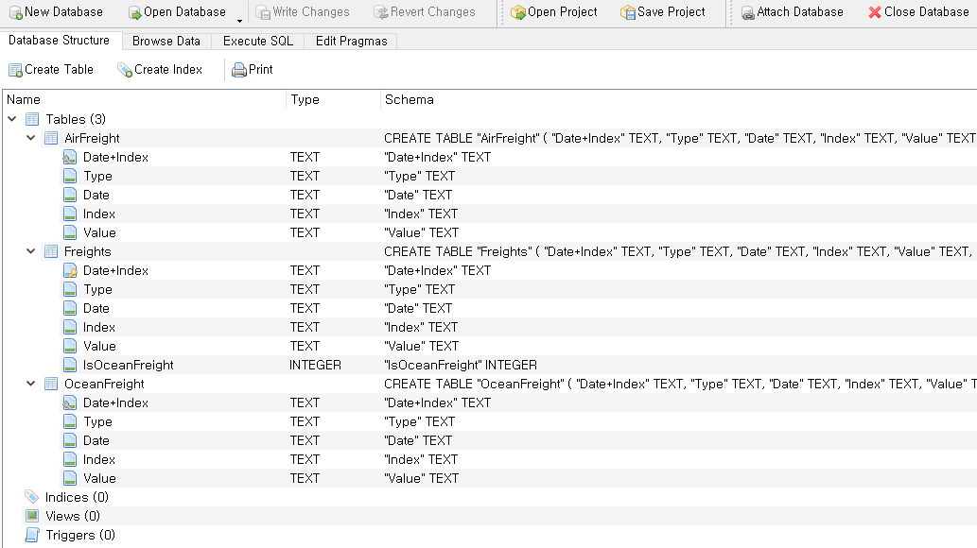
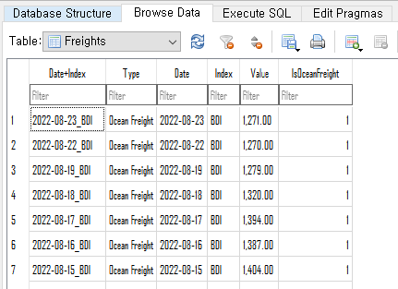
3. Results 》Deliverables (2/2)
Section 3
Storing & Querying
- The team designed the database in SQLite according to the ERD. As a result, It is possible to search and manage stored in the database by running a query.
Deliverables of Project
Entity Relationship Diagram (ERD)
Database in SQLite
Tables in DB

Slide 16
4. Discussion 》 Implication
Section 4
Project Benefits
- The team built a data processing pipeline for freight indexes, which is expected to ensure the work efficiency in the pricing process and data accumulation
Data Pipeline
Benefits
Data Source (Freight Indexes)
Work efficiency in the pricing process
Collecting & Processing
web page A (BDI)
web page B (CCFI)
The efficiency of pricing tasks will be increased as index data can be viewed and managed in one integrated channel.
Data Scraping
Saving it as a CSV file
web page C (SCFI)
< Standardized Form >
Date
Index
Value
···
web page D (HRCI)
web page E (BAI)
2022-08-15
BDI
1,279.00
···
2022-08-15
CCFI
2,993.67
···
···
Data Accumulation
Storing
Creating a Database file
Importing a CSV file into DB
By storing an index for each web page in the database, it becomes possible to develop models and strategies using historical data in the future.
Querying
Running a query

